Slide 1
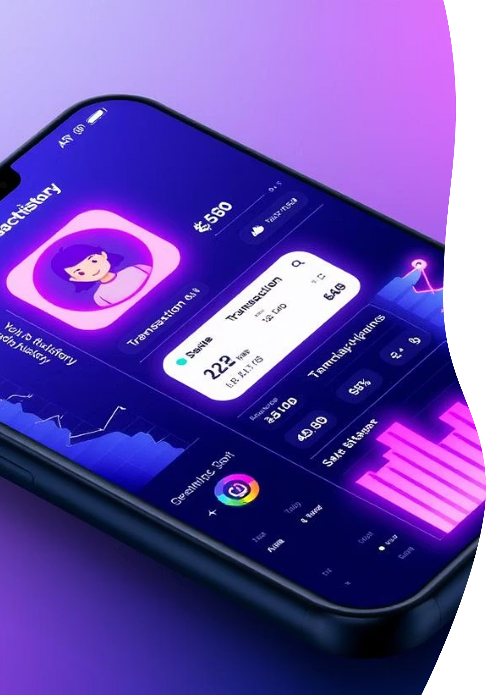
Strategic Insights from PhonePe's Core Business Data
Unlocking Growth through Data-Driven Strategies at PhonePe. This report highlights key findings and proposed solutions from our recent analysis of transaction behaviors and user engagement.

Slide 2


Project Overview: Approach and Objectives
Our project aimed to transform raw data into actionable intelligence by analyzing unexplained variations in transaction behaviors and user engagement across the PhonePe platform.
Data Extraction & Warehousing
Analysis & Visualization
Extracted, cleansed, and loaded comprehensive transaction and user data into a structured SQL data warehouse, creating a "single source of truth."
Used Python and SQL to query data, addressing strategic questions and delivering an interactive business intelligence dashboard for decision-makers.

Slide 3
Geographical Insights & Transaction Dynamics
Finding: Concentrated Value, Distributed Volume
Proposed Solution: Hyper-Local Strategy
Shift from a uniform national strategy to a customized approach. Defend market share and promote premium services in metros. Drive P2M adoption in rural/semi-urban areas with surging UPI adoption (>100% annually).
While transaction volume is widespread, a disproportionate share of transaction value is concentrated in high-income states (e.g., Maharashtra, Karnataka, Telangana). Low-value P2M transactions show explosive nationwide growth.

Slide 4
Insurance Penetration Analysis
Finding: Trust & Complexity Barriers
Proposed Solution: Trust-Led, Education-First
The Indian insurtech market has high growth potential but faces low consumer trust and product complexity. 80% of consumers rely on personal recommendations; 53% abandon online purchases due to difficulty understanding products.
Leverage PhonePe's established trust. Simplify insurance with clear, vernacular educational content (videos, guides). Offer hyper-segmented, needs-based products using granular transaction data, transforming PhonePe into a trusted financial advisor.

Slide 5
Top Performers: Addressing the "Leaky Bucket"
Finding: Operational Failure
Proposed Solution: Product-Led Activation
Many districts excel at user registration but fail to convert them into active transactors, indicating a "Leaky Bucket" phenomenon in the "first mile" of the user journey from onboarding to activation.
In "leaky bucket" geographies, shift focus from marketing-led acquisition to product-led activation. Diagnose and fix friction points: simplify KYC, offer compelling first-transaction incentives, ensure immediate utility from local merchant networks.

Slide 6




Overall Conclusion: A Data-Driven Imperative
PhonePe's future growth and market leadership hinge on a nuanced, data-driven, and hyper-localized approach.
Regional Customization
Positive Personalization
Move beyond a one-size-fits-all model.
Tailor offerings to user needs.
Trust-Led Financial Services
Optimized User Activation
Build on user confidence.
Enhance the first-mile experience.

Slide 7
Strategic Roadmap for PhonePe's Growth
Our analysis reveals key pillars for PhonePe to capitalize on immense growth opportunities within the Indian digital economy.
Personalized User Experiences
Customized Market Engagement
Leverage device data for relevant value delivery.
Implement regional strategies based on economic profiles.
Efficient User Conversion
Trusted Financial Advisory
Fix friction points in the onboarding and activation funnel.
Simplify complex products through education.

Slide 8
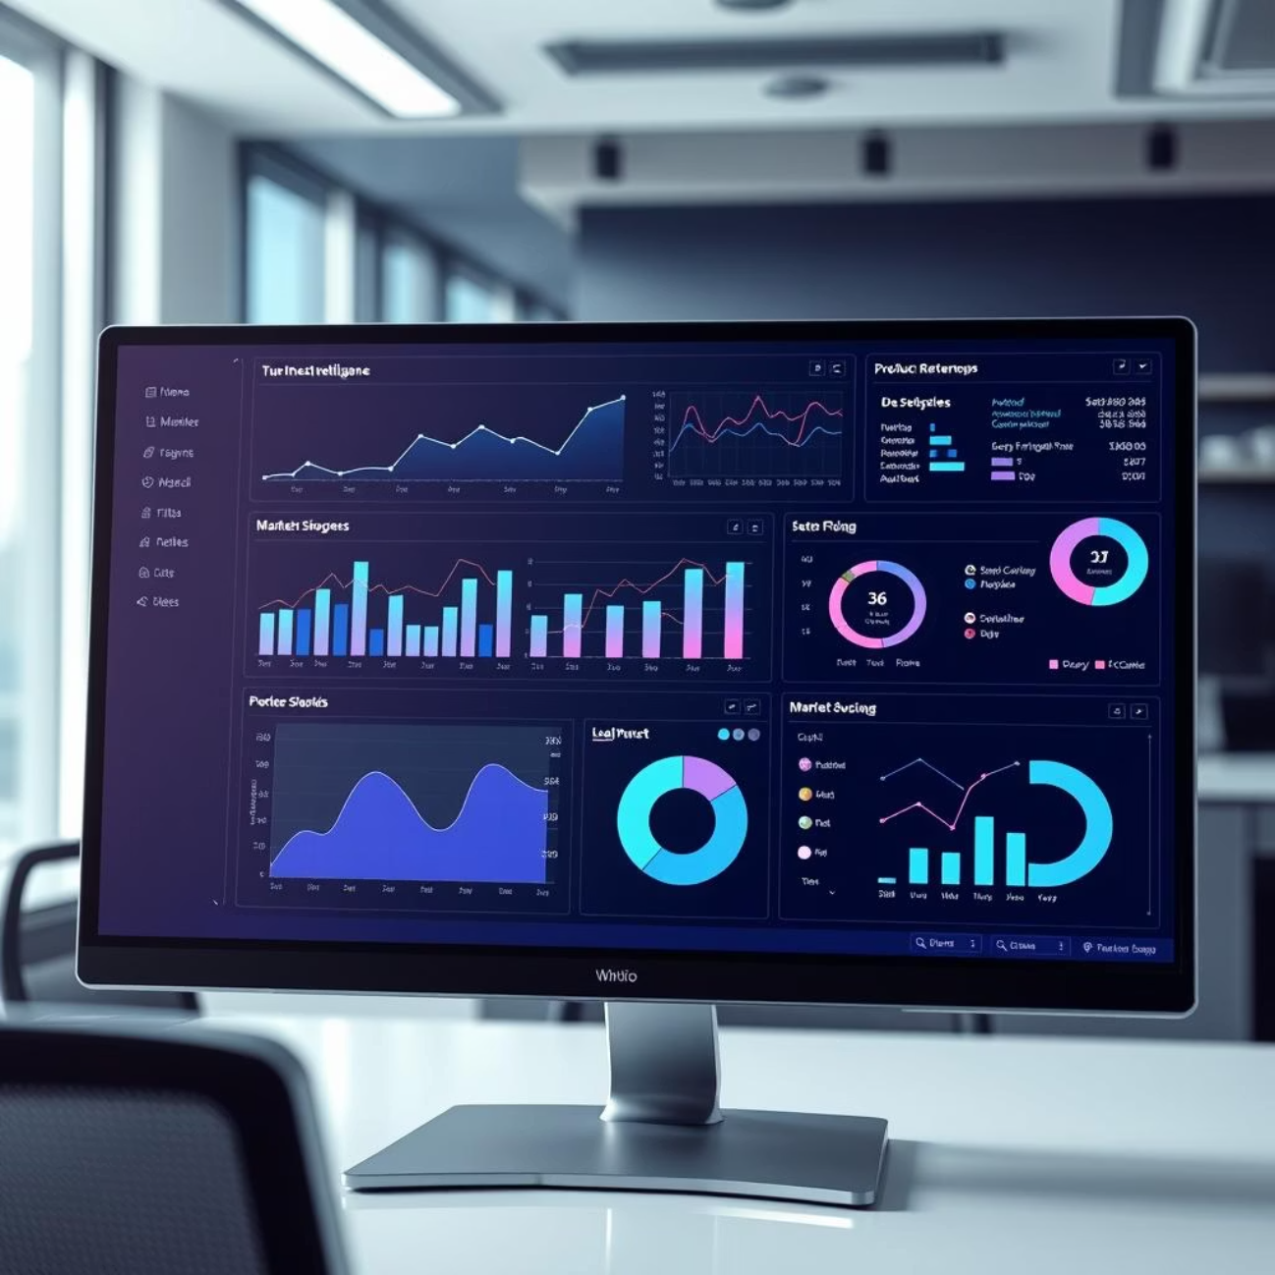
Next Steps: Empowering Decision-Makers
The interactive business intelligence dashboard is now your foundational tool to monitor these initiatives and guide future strategy.
Access comprehensive data insights at your fingertips, allowing for agile, informed decision-making. Leverage detailed performance metrics to track the success of hyper-local strategies and personalized campaigns.
Continuously optimize user activation by pinpointing and resolving friction points in real-time. Drive PhonePe's continued leadership in the dynamic Indian digital economy with data-backed precision.

